Slide 1
Direct Mail Retargeting

Slide 2
Premise: A Human Contact
Each day, consumers see:
Thousands of Digital, Linear, CTV and OTT ads
Hundreds of emails
A handful of Direct Mail pieces.
The chance of getting your message noticed via Direct Mail is just mathematically, exponentially, greater compared to any other channel.

Slide 3
Reach Interested Consumers
Direct Mail to high intent website traffic delivers a message to a prospect already interested
Creates a “kitchen-table moment” where your message persists in the house for days, versus overlooked emails or ignored ads
Only mails if matched to an address, so no impression is wasted

Slide 4
Direct Mail + Retargeting
Matches 30%+ of anonymous website visitors to mailable addresses*
Postcards automatically mailed daily to the budgeted amount set by client*
Combines the high response rates of Direct Mail + relevance of Retargeting
*more details to follow

Slide 5
An evergreen marketing channel
Designed to be ongoing and support all other marketing efforts
Takes advantage of existing website traffic
Consistent, reliable results across all business types and sizes
Presented not as a campaign, but as an additional marketing channel

Slide 6
Feature Highlights
Address Matching: Cookie-based approach
Targeting: By page, geography, intent
Budget: Flexible and “no minimums”
Suppression: conversions, repeat visitors, customers
Creative: Multiple if needed
Results: Tracking online purchases, visits

Slide 7
Address Matching
Cookie-based approach connects device ID to opt-in subscriber network
Privacy compliant
Matches from mobile and desktop
Name and address match and printing
Usually 50%+ match rate, sometimes higher if website audience are stable homeowners
NOT IP-based matching, which is less accurate and uses lat-long for address (no apartment buildings)

Slide 8
Targeting
Screen out bounces and only mail to higher intent by assigning minimum page visits (2+, 3+ pages, etc.)
Assign specific pages as the targets, like abandoned carts or a best-selling product
Geographic selects of Zip Codes or States
Excludes and/or includes to narrow the focus of who gets mailings – recommended mostly for very high trafficked sites

Slide 9
Budget
Budget is determined by the number of actual mailed cards – per Filters – and $$$ allocation
Recommend as ongoing monthly budget of $$$ per month, then determine number of cards per day
Flexible to adjust up or down pending seasonality, sales events, budget opportunities
Billed weekly for cards mailed that week

Slide 10
Suppression
Suppress repeat visitors who return to site within specific date range – default is 30 days
Suppress list of existing customers
Suppress “conversions” who land on the actual purchase confirmation page (more in Conversion)

Slide 11
Creative
4.25 x 6 and 6 x 9 cards available
You can mail multiple creatives – abandoned cart, general, etc.
Most websites are fine with a single creative that tells the story and has an exclusive offer
Modern iO Design Guide to help your discussions with clients – this is a unique channel

Slide 12
Results
Measure return-to-site visit and conversions (where applicable) via Dashboard
Matchback analysis available at 45 and 90 days (requires customer transaction file)

Slide 13
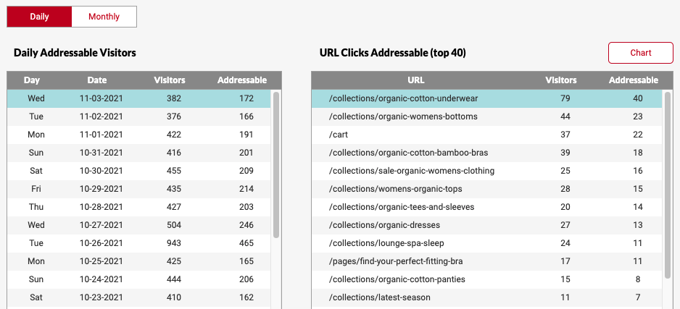
Dashboard – Visitors & Addressables

Slide 14
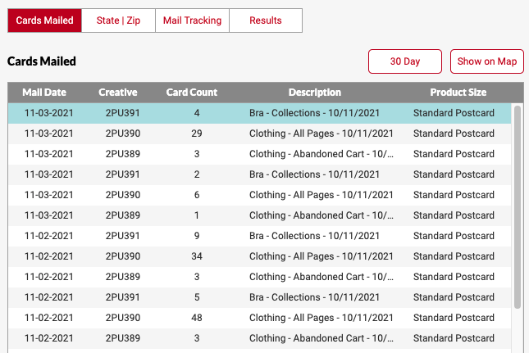
Dashboard – Cards Mailed

Slide 15
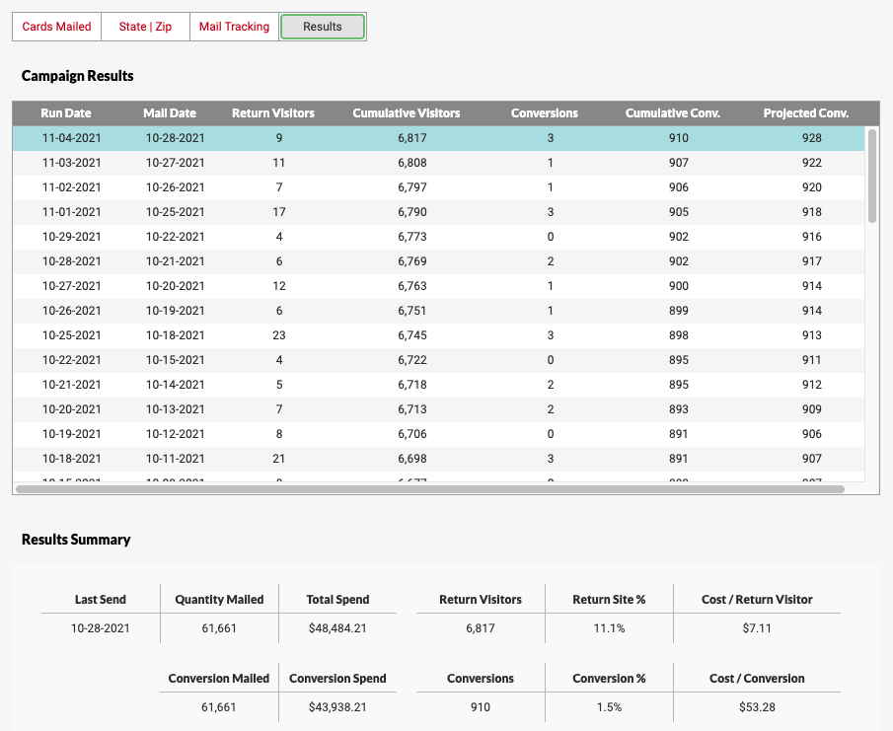
Dashboard – Daily Results

Slide 16
Dashboard – Summary Results

Slide 17
Next Steps
Questions?
Preparing and placing a TAG is no cost, no obligation
Shows initial traffic and addressable opportunity

